Slide 1
DATA ANALYSIS REPORT
Intention is to find best approach to increase revenue and optimize sales performance.

Slide 2
The provided dataset underwent thorough validation and cleaning to ensure accuracy and consistency. The following steps were taken for each column:
Data Validation
week | sales_method | customer_id | nb_sold | revenue | years_as_customer | nb_site_visits | state
0 | 2 | Email | 2e72d641-95ac-497b-bbf8-4861764a7097 | 10 | NaN | 0 | 24 | Arizona
1 | 6 | Email + Call | 3998a98d-70f5-44f7-942e-789bb8ad2fe7 | 15 | 225.47 | 1 | 28 | Kansas
2 | 5 | Call | d1de9884-8059-4065-b10f-86eef57e4a44 | 11 | 52.55 | 6 | 26 | Wisconsin
3 | 4 | Email | 78aa75a4-ffeb-4817-b1d0-2f030783c5d7 | 11 | NaN | 3 | 25 | Indiana
4 | 3 | Email | 10e6d446-10a5-42e5-8210-1b5438f70922 | 9 | 90.49 | 0 | 28 | Illinois

Slide 3
Data Validation Steps:
The provided dataset underwent thorough validation and cleaning to ensure accuracy and consistency. Here are the general steps taken in order to ensure that the data were ready for analysis were:
data type check: Reason: Ensure that each column contains the expected data type e.g., numeric, categorical, etc.
- Anomaly handling: If a column contains an unexpected data type, convert it to the correct type or remove rows with incorrect data types.)
missing value check: This is the most appropriate step to be taken first, especially for numeric data. As missing values can lead to errors or biases in analysis if not handled properly.
outlier detection(using z-score): Identify data points that are significantly different from the majority of the data. - Anomaly handling: Remove outliers, transform the data (e.g., log transformation), or use robust statistical methods to reduce their impact
data range check: Ensure that values in each column fall within expected ranges.
- Anomaly handling: Remove values outside the expected range, truncate them to the range boundaries, or use data transformation techniques (e.g., normalization).

Slide 4
Data Validation Steps(contd):
data consistency check: Ensure that categorical values are consistent and follow expected patterns.
- Anomaly handling: Correct inconsistent values to the expected values, or remove rows with inconsistent values.
data distribution check Ensure that data distributions are as expected (e.g., normal, uniform, etc.).- Anomaly handling: Transform the data (e.g., normalization, standardization), or use robust statistical methods to account for non-normality.
correlation analysis: Identify strong correlations between columns.
- Anomaly handling: Remove one of the correlated columns to avoid multicollinearity issues in modeling.

Slide 5
Data Validation Steps(contd):
data quality metrics(data completeness): Assess the overall quality of the data.
- Anomaly handling: Address issues (e.g., low completeness, high inconsistency) before proceeding with analysis.
visual inspection: Visually examine the data to identify potential issues.
- Anomaly handling: Address issues (e.g., outliers, non-normality) using appropriate techniques (e.g., data transformation, outlier removal).
data profiling(using summary statistics): Gain a deeper understanding of the data distribution and summary statistics.
- Anomaly handling: Address issues (e.g., skewness, kurtosis)

Slide 6
Data Validation Steps(contd):
Here are the steps taken in order to ensure that every column in the dataset is validated and cleaned:
week: I checked for negative and non-numeric values, neither negative nor non-numeric values were found
sales_method: I checked for invalid & unknown values and consistent formatting. Inconsistent(non-alphabetic characters were found in this column), and they were handled appropriately. Lastly, the data type from this variable was converted to categorical data type, in order to enhance the suitability of the column to the intended purpose of the analysis
customer_id: This column was dropped because it was not necessary to the analysis.
nb_sold: I checked for negative and non-numeric values, neither negative nor non-numeric values were found.
revenue: Missing values were found in this column, and were handled appropriately. I checked for negative and non-numeric values, neither negative nor non-numeric values were found.
years_as_customer: I checked for negative and non-numeric values, neither negative nor non-numeric values were found..

Slide 7
Data Validation Steps(contd):
nb_site_visits: I checked for negative and non-numeric values, neither negative nor non-numeric values were found..
state: I checked for invalid & unknown values and consistent formatting. Invalid and unknown values were not found. But Inconsistent(non-alphabetic characters were found in this column), and they were handled appropriately.
Here are the summary of the data cleaning steps used:
Checked for number of rows and columns Checked the first few rows (default is 5) of the dataframe, allowing us to quickly understand the data structure, column names, verify data loading, verify data quality(like: missing values, outliers, formatting errors etc.) and get an idea of data distribution, and for missing values in the dataframe.

Slide 8
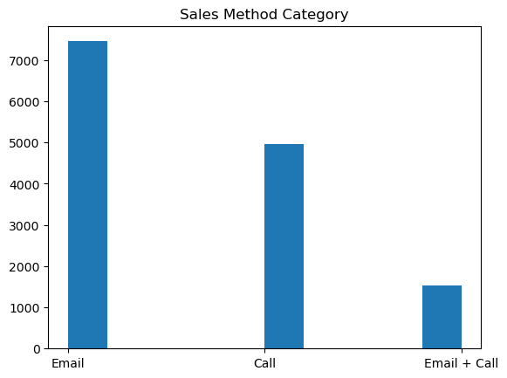
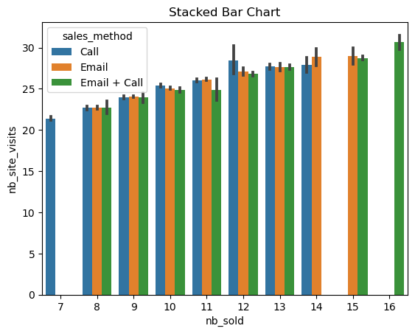
Exploratory Analysis:
Histogram indicates that the most used sales method is Email, not the most effective.
Stacked bar chart displays that as nb_site_visits increases, nb_sold increases. Using pearson correlation, nb_site_visits vs nb_sold has moderate positive correlation.

Slide 9
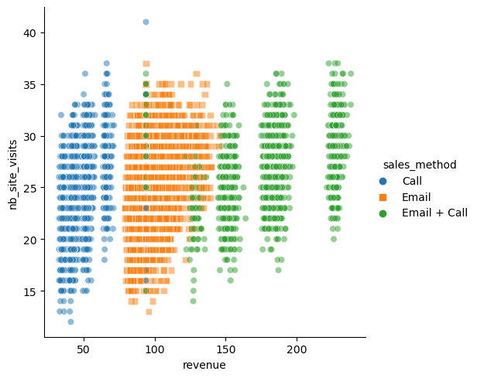
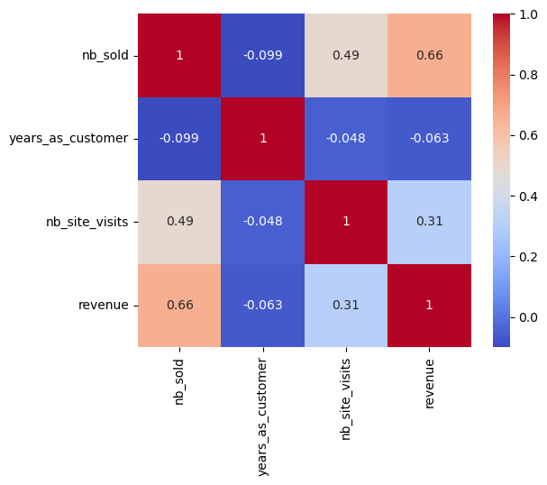
Heatmap indicates that there is positive moderate correlation between site visites and number of sold products
Heatmap indicated that there is negative correlation between years_as_customer and revenue.
Scatter plot indicates that the most effective sales method is Email + Call

Slide 10
Findings
3.482271
When a scatter of revenue vs number of sites visits was also plotted, sales method was used as the hue. The most effective sales method is Email + Call according to the scatter diagram.
Email + Call has the highest total sum and average revenue generated.
States with the highest revenue generation are California and Texas, and the most sales method used is 'Email‘, probably because more Email messages were sent compared to Call or combination of Email + Call, according to the histogram. While states with least revenue generation used 'Call' as their sales method(which is the least effective method).

Slide 11
Findings contd.
3.482271
There is a moderate positive correlation between the number of site visits (nb_visits_site) and the number of sold items (nb_sold), indicating that as site visits increase, sold items also tend to increase.
Average Revenue Per site Visits(which is a useful metric to evaluate the effectiveness of the website) is $3.48. Unsurprisingly, the most effective sales method in this regard is Email, probably because more Email messages were sent compared to Call or a combination of Email + Call, according to the histogram.
Site Visit Conversion Rate (Tracking this metric can help us get a feel of how well your marketing strategy is working) is 40%. Not too bad, but it can definitely be better.
Average Customer lifetime value (ACLV) (this value takes into account all potential transactions to be made during a customer relationship timespan and calculates the specific revenue from that customer) is $422.92.

Slide 12
Final Summary:
This data analysis report provides insights into the effectiveness of sales methods and the relationship between site visits and sold items, performance of each state, and the connection between each of the columns.
The findings suggest that Email + Call was the most effective sales method, if the 3 categories of sales method were used the same number of times, and there is a moderate positive correlation between site visits and sold items. These insights can inform business decisions and guide marketing strategies to optimize sales and revenue.

Slide 13
Recommendation:
Based on the findings, it is recommended to:
Focus on the Email + Call sales method as the primary approach.
Invest in strategies to increase site visits, such as search engine optimization, social media marketing, and targeted advertising.
Monitor and analyze the relationship between site visits and sold items to refine marketing strategies and optimize revenue.
There is need for continuous awareness creation on the part of the marketing team to constantly bring new customers, as years as customer as negative correlation on number of sold items and revenue generation as indicated by the heat map.
Continuously validate and clean the dataset to ensure accuracy and consistency.
By implementing these recommendations, the business can potentially increase revenue and optimize sales performance.

